Slide 1

Introduction to Lambda Calculus
λg.(λx.g(xx))(λx.g(xx))?

Slide 2
Introduction to Lambda Calculus
λg.(λx.g(xx))(λx.g(xx))?
Well, Really…

Slide 3
Introduction to Lambda Calculus
λg.(λx.g(xx))(λx.g(xx))?
Well, Really…
(λg.(λx.g(xx))(λx.g(xx)))
(λp.p(λab.b)(λ.xab.a))?

Slide 4
Introduction to Lambda Calculus
Y =
λg.(λx.g(xx))(λx.g(xx))?
Well, Really…
(Y NOT) =
(λg.(λx.g(xx))(λx.g(xx)))
(λp.p(λab.b)(λab.a))?

Slide 5
What is the Lambda Calculus?
The lambda calculus is a formal system in mathematical logic for expressing computation.
It captures and represents FUNCTIONS, PARAMETERS, VALUES, and calculation via APPLICATION.
Devised by Alonzo Church in 1936.
At the heart of some great languages, like Lisp and Haskell.

Slide 6
Why Should I Care About the Lambda Calculus
It is fundamentally interesting.
It relates to computer programming, and many sub-domains of philosophy.
In particular, lambda calculus is central to functional programming languages, such as ML and Haskell, and to Lisp.
Understanding the lambda calculus will probably help make these languages' performance more intuitive for you.

Slide 7
Lamba Calculus is Not the Only Model of Computation
Turing Machine
  Invented by Alan Turing
  Mechanistic model
μ-Recursive Functions
Others
  (finite state machines, automata, etc.)

Slide 8
Early History of Lambda Calculus
Background: David Hilbert’s Entscheidungsproblem (‘Decision Problem’, or
‘Halting Problem’):
  Is there one (or more) algorithm that can determine, given an arbitrary statement of first order predicate logic, whether the statement is TRUE or FALSE?
In 1936, Alonzo Church wrote a paper on the Entscheidungsproblem, using his new lambda calculus, proving that such an algorithm cannot exist.
Two months later but also in 1936, independently, Alan Turing wrote a paper, using his Machine, reaching the same conclusion.
The Lambda calculus, the Turing Machine, and μ-recursive functions have been shown to be equivalent.

Slide 9
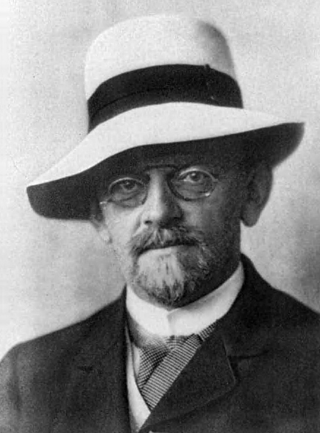
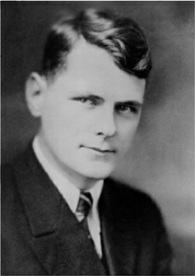
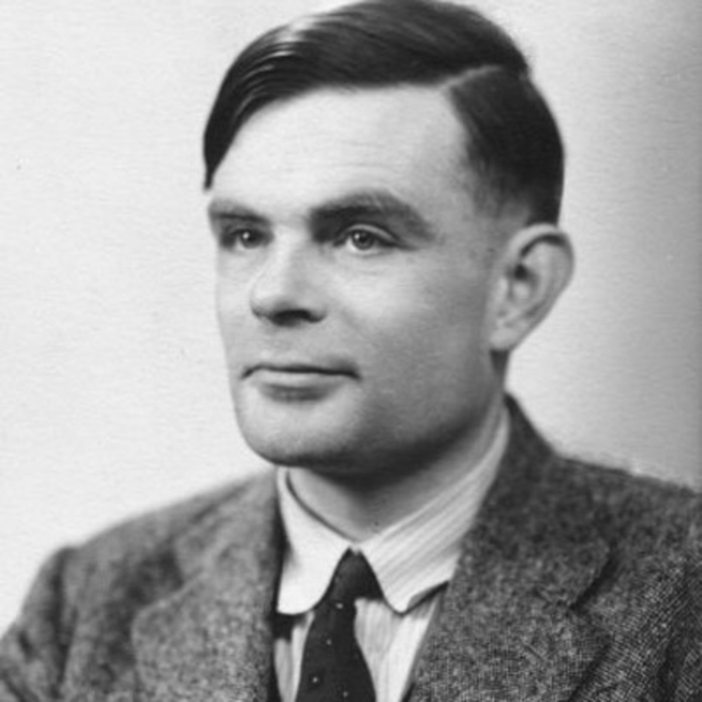
Hilbert, Church, Turing

Slide 10
What is a “Calculus”?
A system of
  Symbols
  Rules to construct valid expressions using the symbols
  Rules to operate on symbols to generate new expressions
  Usually one has a goal to find a terminal expression that cannot be further manipulated. This is an “evaluation” or “solution”.
  But, some expressions cannot be reduced to a terminal form.

Slide 11
What is an “Operator”?
Informally, an operator is an abstract thing that acts on other abstract things (“inputs”, “parameters”, “values”) and produces another abstract thing (“output”, “result”, “evaluation”)
The inputs can be of any types, and the result need not be of the same as any of the inputs.

Slide 12
Examples of Operators
"+" is an operator that takes one or more numbers, sums them, and returns a number.
"&&" is an operator that takes two Boolean values and returns one Boolean value.
">" takes two things and returns a Boolean value based on whether the value "to the left" is "larger" than the value "on the right".
“λ" – The mighty lambda takes a parameter symbol, an expression, and zero or one value, and returns an expression.

Slide 13
What is “Lambda”? – “λ”
Lambda is the operator that, through ‘application’,
operates on three things: one parameter symbol, one expression, and one value, and
results in an expression, which might contain
  one or more lambda operator-parameter pairs,
  an expression that might be operated on by any remaining lambda operator, and
  a smaller value list

Slide 14
Grammar of Lambda Expressions
<Exp> ::= | an expression is any of
<ident> | an identifier (a ‘variable’)
<constant> | a constant such as 5 or ‘a’
λ <ident> . <Exp> | -- a lambda expression, a function abstraction
<Exp> <Exp> | one expression can comprise multiple expressions
( <Exp> ) | parentheses are used to indicate precedence
<ident>:= any string of symbols, except
( λ . )
Parentheses are “math-like”, not “Lisp-like”
Associativity is to the left: abc = (ab)c = ((ab)c)
Parentheses can be removed if left-associativity is respected

Slide 15
Structure of a Function Abstraction
The λ operator
An identifier to serve as a parameter
A . to divide the “head” from the “body”
An expression as the body
Example: λa.xay
λ a . xay
The mighty λ parameter divider body
^-------------head-------------^^-------- body-^

Slide 16
Valid Expressions
a - simple variable
λa.a - function (this happens to be the ID function)
λa.λb.aba - two-parameter function (really curried functions)
λa.λb.a(ba) - parentheses to specify precedence
(λa.λb.aba)x - function with a value “x” (can be bound to parameter)
(λa.λb.a(λx.yx))a - function evaluation expression can contain lambda expressions
(λa.λb.aba)(λx.yx) – values to be bound to parameters can be lambda expressions

Slide 17
Invalid Expressions
λ - λ must have one parameter expression and a body
(λa.) - . must be followed by an expression
λa..a - . must be preceded by λ and a parameter
λa.(aba - parentheses must be balanced

Slide 18
The (Meat of the) Operation: β reduction
The Parameter is Bound to the first expression after the Body of the Abstraction
Every instance of the Parameter in the Body is replaced with the Bound Value
(λa.ax(ay)a)r
[axaya a := r]
“Application” of a function to a Value “eats” the lambda, the parameter symbol, and the dot, and maybe a matching pair of parentheses (since they are math-like)
Evaluates to rx(ry)r

Slide 19
Bound and Unbound Variables
A variable in a body of a lambda expression is bound if it occurs as a parameter for a lambda operator, and is unbound, or free, if not.
In λa.ax, a is bound, and x is unbound (or free)
Note: in (λa.ax)x, x is still unbound, because the second x is not within the lambda expression. It is ‘out of scope’.

Slide 20
Multiple Heads – Nested Lambdas
(λa.λb.λc.xay)f g r
Is valid. λa., λb., and λc are nested.
(λa.λb.λc.xay)f g r
(λb.λc.xay) g r a := f
(λb.λc.xfy) g r
Note: Evaluation can continue from here.

Slide 21
Syntactic Sugar for Nested Lambdas
Commonly, nested lambdas are combined by removing all but the first λ and all but the last .
λa.λb.λc.(xay)f g r
can also be written
λabc.(xay)f g r

Slide 22
Count of Parameters and Count of Values can Differ
(λa.xay)f g r
evaluates to
(xfy) g r
xfygr
This is as far as we can go, because no lambda expression exists anymore.
(λa.λb.zab)f
evaluates to
λb.zfb
this second one is partial application, evaluating to a function “waiting” for one input.

Slide 23
Parameters might not occur in expression applied to value
λa.(xby)f
evaluates to
xby
the f is discarded, because the parameter a does not occur in the body.

Slide 24
Lambda Expressions can occur in the expression applied to a value.
(λa.(λb.(ab)a))f g
evaluates to
λb.(ab)a g [a := f]
λb.(fb)f g
then to
(fb)f [b := g]
fgf

Slide 25
Lambda Expressions can be Passed In as values to be bound to parameters
”Lambda expressions are first class”
(λa.axd)((λb.b)f)
(axd) f [a := λb.(b)]
(λb.b)xd f
(λb.b)xdf [b := xdf]
xdf

Slide 26
Normal form and its Malcontents
A lambda expression that cannot have beta reduction further applied is said to be in normal form.
The expression λa.(xby)f evaluates to the normal form xby
However, the expression (λa.aa)λa.aa (the omega (ω) combinator) evaluates, in one step, to (λa.aa)λa.aa
(λa.aa)λa.aa
aa [a:= λa.aa]
(λa.aa)λa.aa
No normal form

Slide 27
α Equivalence
Each symbol has consistent meaning only within its lambda expression.
So, the following are equivalent:
λbc.b
λxc.x
While these are not (unless f = z)
λc.af
λc.az

Slide 28
α Conversion
(λab.ab)b -looks like it might simplify to
λb.bb
But the bs in the abstraction and the b as the value are only accidentally represented by the same symbol.
Since a parameter symbol is meaningless outside of its abstraction, we should replace b, as a parameter and in the body, with another symbol.
(λab.ab)b
To
(λaz.az)b
Yielding
λz.bz

Slide 29
Parameters need not appear in the body
In this case, the value bound to the parameter is simply discarded.
(λb.cd)x
Yields
cd
Since b does not occur in the body, cd

Slide 30
We might bind all parameters before we run out of values.
(λab.acb)def
Yields dcef
The parameter a is replaced with d, and the parameter b is replaced with e. No parameter remains to bind f.

Slide 31
We might bind all values before we run out of parameters.
(λabcd.acb)xr
λcd.xcr
The result is a function awaiting one more value (that will yield a third function awaiting one value), or, equivalently, a function awaiting two values.
This is Partial Application.

Slide 32
What can we do with this? Everything Possible (but not today)
We can carry out calculations in some space by finding
functions that can be used to encode values in our space
functions that manipulate these encoded values in ways that evaluate to correct resultant expressions in our space.

Slide 33
Example: Encode T/F, Build Boolean Functions
TRUE is often encoded as λab.a, and FALSE as λab.b.
These are usefully distinct and “opposite”. TRUE returns the first of two parameters, and FALSE the second.
This can be expressed as
TRUE := λab.a
FALSE := λab.b

Slide 34
Example: Build “NOT”
NOT is the function that
- takes one Boolean value p, and
- returns FALSE if p is TRUE, and TRUE if p is FALSE.
NOT := λ(one parameter).(an expression that
evaluates to either TRUE or FALSE)

Slide 35
Example: Build “NOT”
NOT is the function that takes one Boolean value, and returns FALSE if P is TRUE, and TRUE if P is FALSE.
NOT := (λp.p FALSE TRUE)
If p is TRUE, it returns the first of two following values (in this case, FALSE), and vice versa.

Slide 36
Let’s Try Using Our NOT!
(λp.p FALSE TRUE) FALSE
(λp.p FALSE TRUE) (λab.b)- FALSE as encoded
(p FALSE TRUE) [p := (λab.b)]
(λab.b) FALSE TRUE
λb.b TRUE [a := FALSE, i.e. λab.b]
λb.b a does not occur, discarded
b [b := TRUE]
TRUE

Slide 37
Example: Build “OR”
OR is the function that takes two Boolean values, and returns TRUE IF one or both are TRUE, and FALSE if both are FALSE.
OR := λpq.(something (T/F)(something else T/F)

Slide 38
Example: Build “OR”
“OR” is the function that
- takes two Boolean values, and
- returns TRUE IF one or both are TRUE, and FALSE if both are FALSE.
OR := (λpq.ppq)

Slide 39
Let’s Try OR!
We’ll bind p to FALSE, and q to TRUE.
(λpq.ppq) FALSE TRUE [p := FALSE]
(λq. FALSE FALSE q) [q := TRUE]
FALSE FALSE TRUE [FALSE := (λab.b)]
(λab.b) FALSE TRUE [a := FALSE, discard]
(λb.b) TRUE [b := TRUE]
TRUE

Slide 40
We can combine functions!
NOR pq
NOR:= λp.λq.(λm.m(λa.λb.b)(λa.λb.a))((λp.λq.p(λa.λb.a)q)pq)

Slide 41
Resources
Online tutorial with REPL - https://lambdaexplorer.com/
Y Combinator in Ruby -
https://www.youtube.com/watch?v=FITJMJjASUs or https://tinyurl.com/ruby-conf-y-combinator
Many combinators in Javascript
https://www.youtube.com/watch?v=pAnLQ9jwN-E or https://tinyurl.com/flock-of-functions
To Mock a Mockingbird – Raymond Smullyan
Explores combinatory logic using metaphor of birds and their songs
Elements of the Theory of Computation - Harry Lewis, Christos H. Papadimitriou
LOTS of good stuff – grammars, expressions, automata, Turing Machines...

